Slide 1
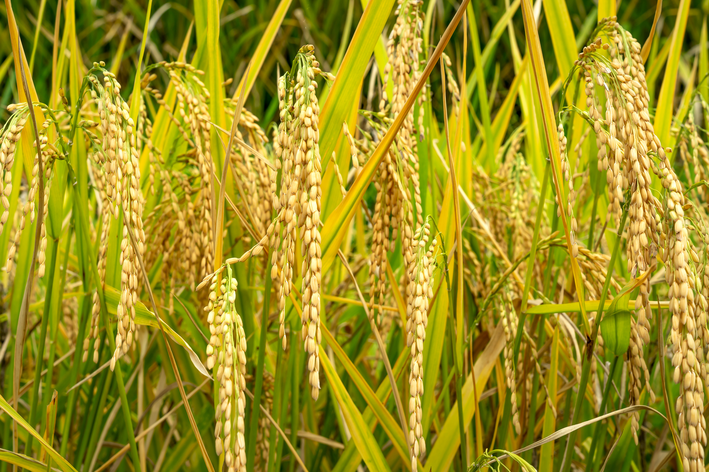

Agriculture Data Analysis & Visualization
SQL Data Wrangling + Interactive Dashboard
Presented By : Rupal K. Giradkar

Slide 2
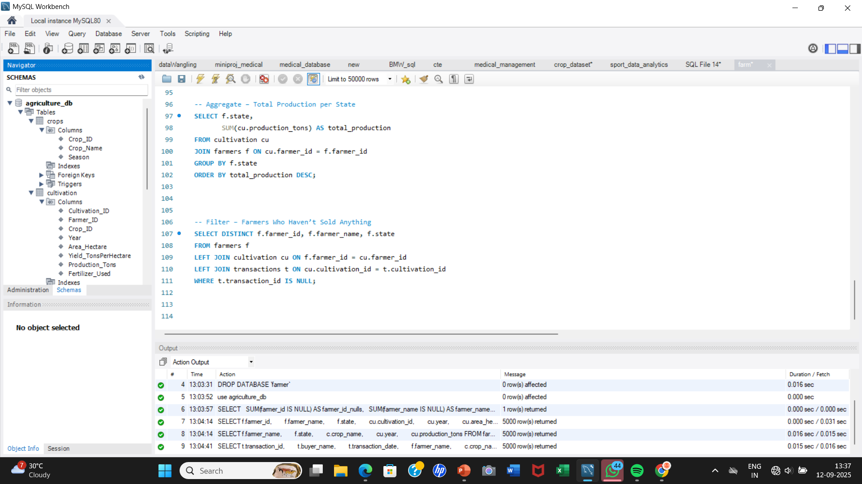
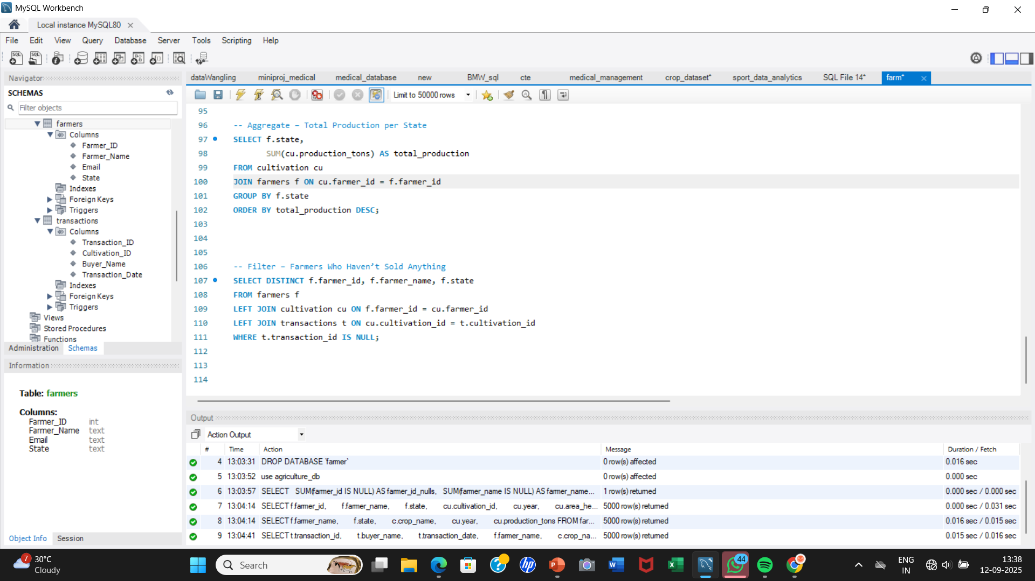
Project Overview
Database: agriculture_db
Tables:
Farmers → Farmer details (ID, Name, State, Email)
Crops → Crop info (Name, Season, Type)
Cultivation → Cultivation details (Farmer, Crop, Year, Area, Production, Fertilizer)
Transactions → Sales info (Buyer, Date, Cultivation_ID)

Slide 3
Objective:
Analyze agricultural production across states and crops
Identify top-performing farmers and crops
Build interactive visualizations for insights

Slide 4
Questions
Basic:
How many farmers are registered in the dataset?
Which fertilizer is used the most across cultivations?
What is the total production for each state?
Intermediate: 4. What is the average yield (tons per hectare) of each crop? 5. How has agricultural production changed year by year? 6. Which 3 crops have the highest total production? 7. Which fertilizer gives the highest average yield?
Advanced: 8. Which farmers have not sold any crops? 9.What is the cumulative production trend over the years?

Slide 5
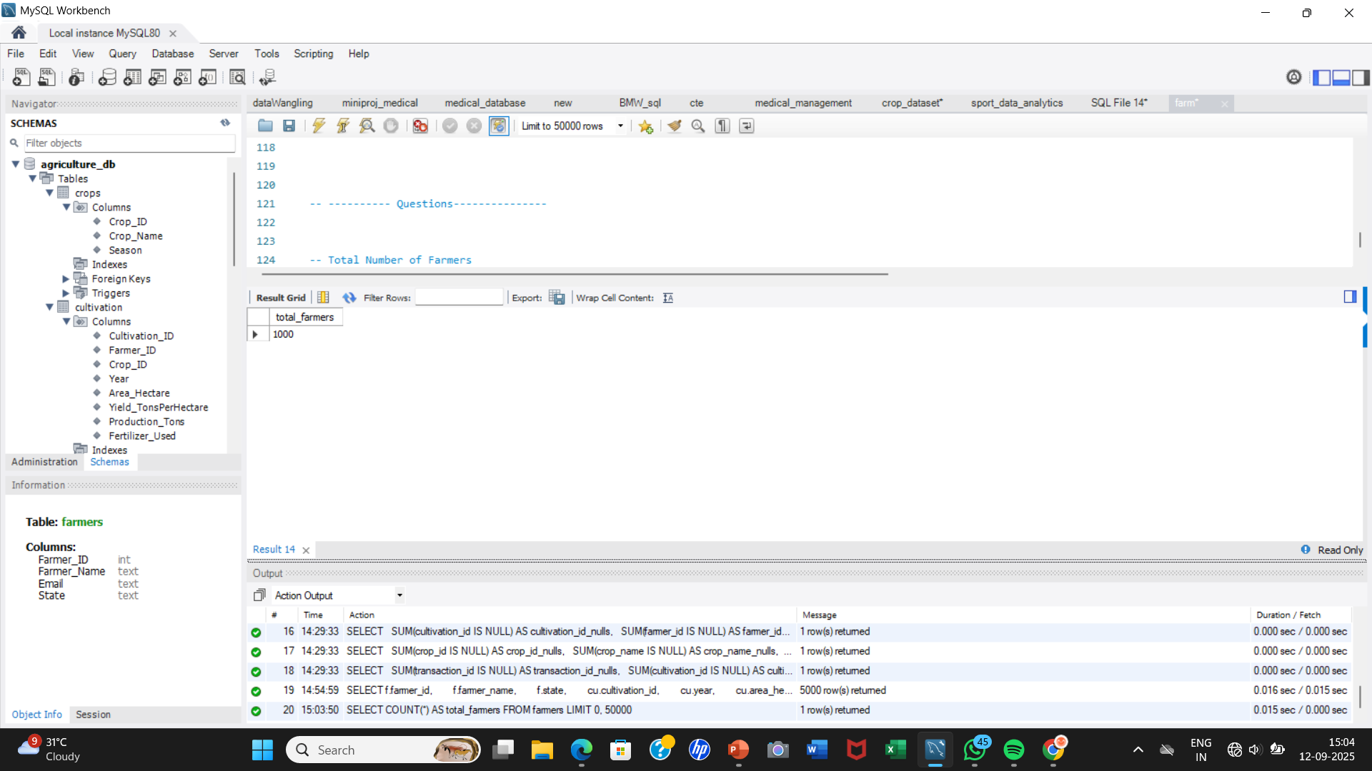
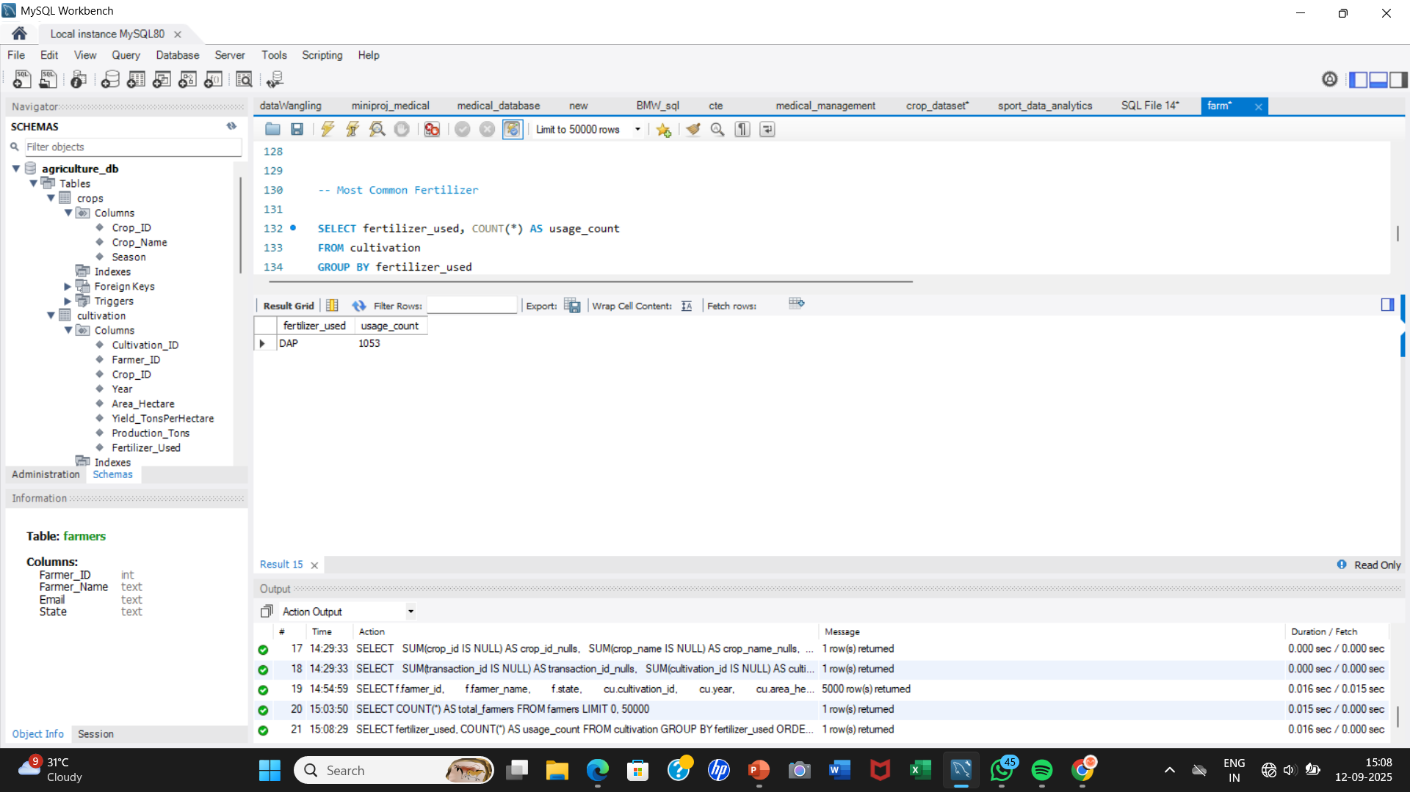
Total Number of Farmers
SELECT COUNT(*) AS total_farmers
FROM farmers;
## This gives the total number of registered farmers.
2) Most Common Fertilizer
SELECT fertilizer_used, COUNT(*) AS usage_count
FROM cultivation
GROUP BY fertilizer_used
ORDER BY usage_count DESC
LIMIT 1;
## Finds which fertilizer is used the most across cultivations.

Slide 6
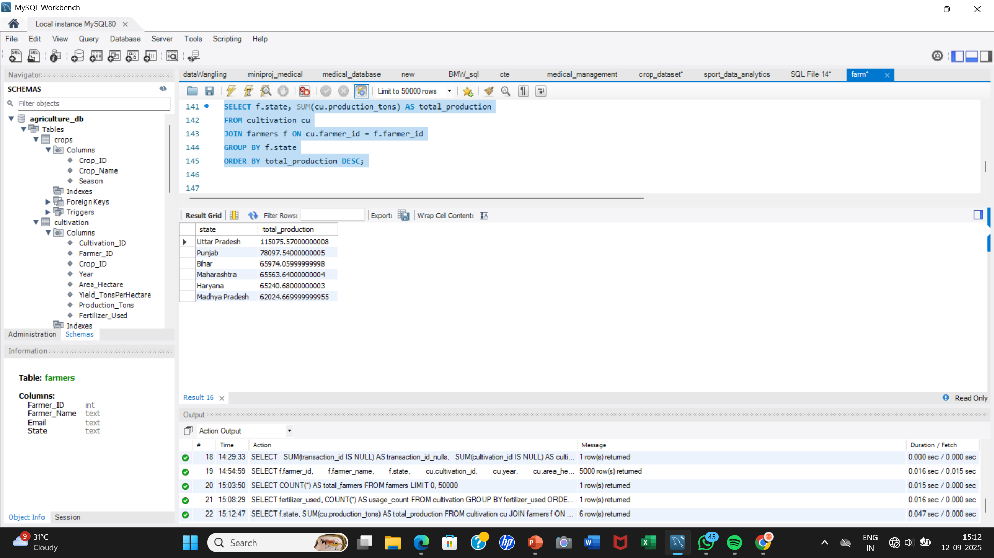
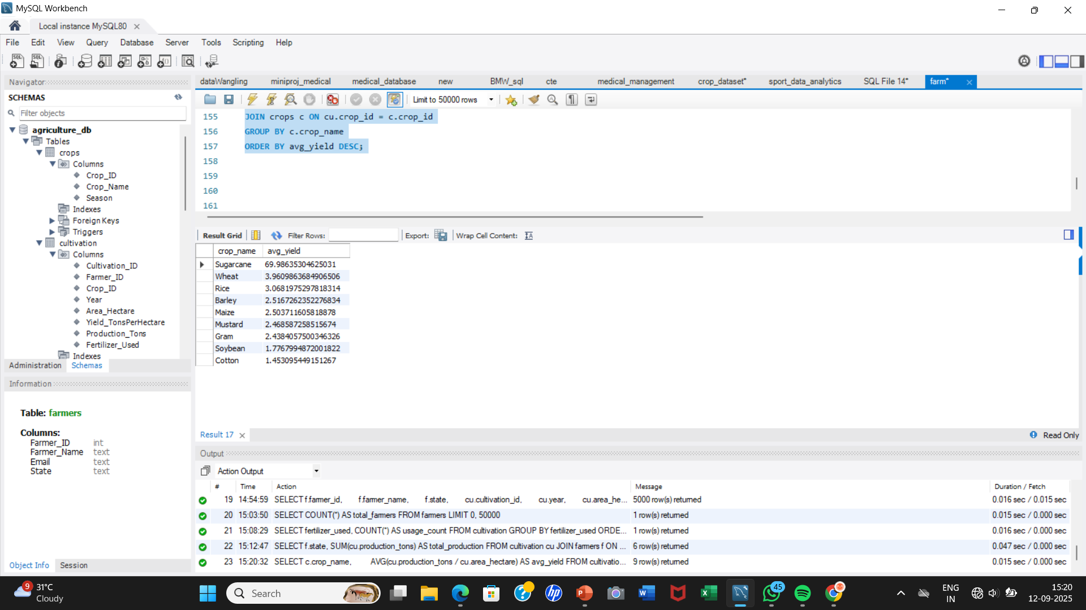
State-wise Production
SELECT f.state, SUM(cu.production_tons) AS total_production
FROM cultivation cu
JOIN farmers f ON cu.farmer_id = f.farmer_id
GROUP BY f.state
ORDER BY total_production DESC;
## Compares agricultural output across states.
Crop-wise Yield
SELECT c.crop_name,
AVG(cu.production_tons / cu.area_hectare) AS avg_yield
FROM cultivation cu
JOIN crops c ON cu.crop_id = c.crop_id
GROUP BY c.crop_name
ORDER BY avg_yield DESC;
## Shows efficiency of each crop (tons/hectare).

Slide 7
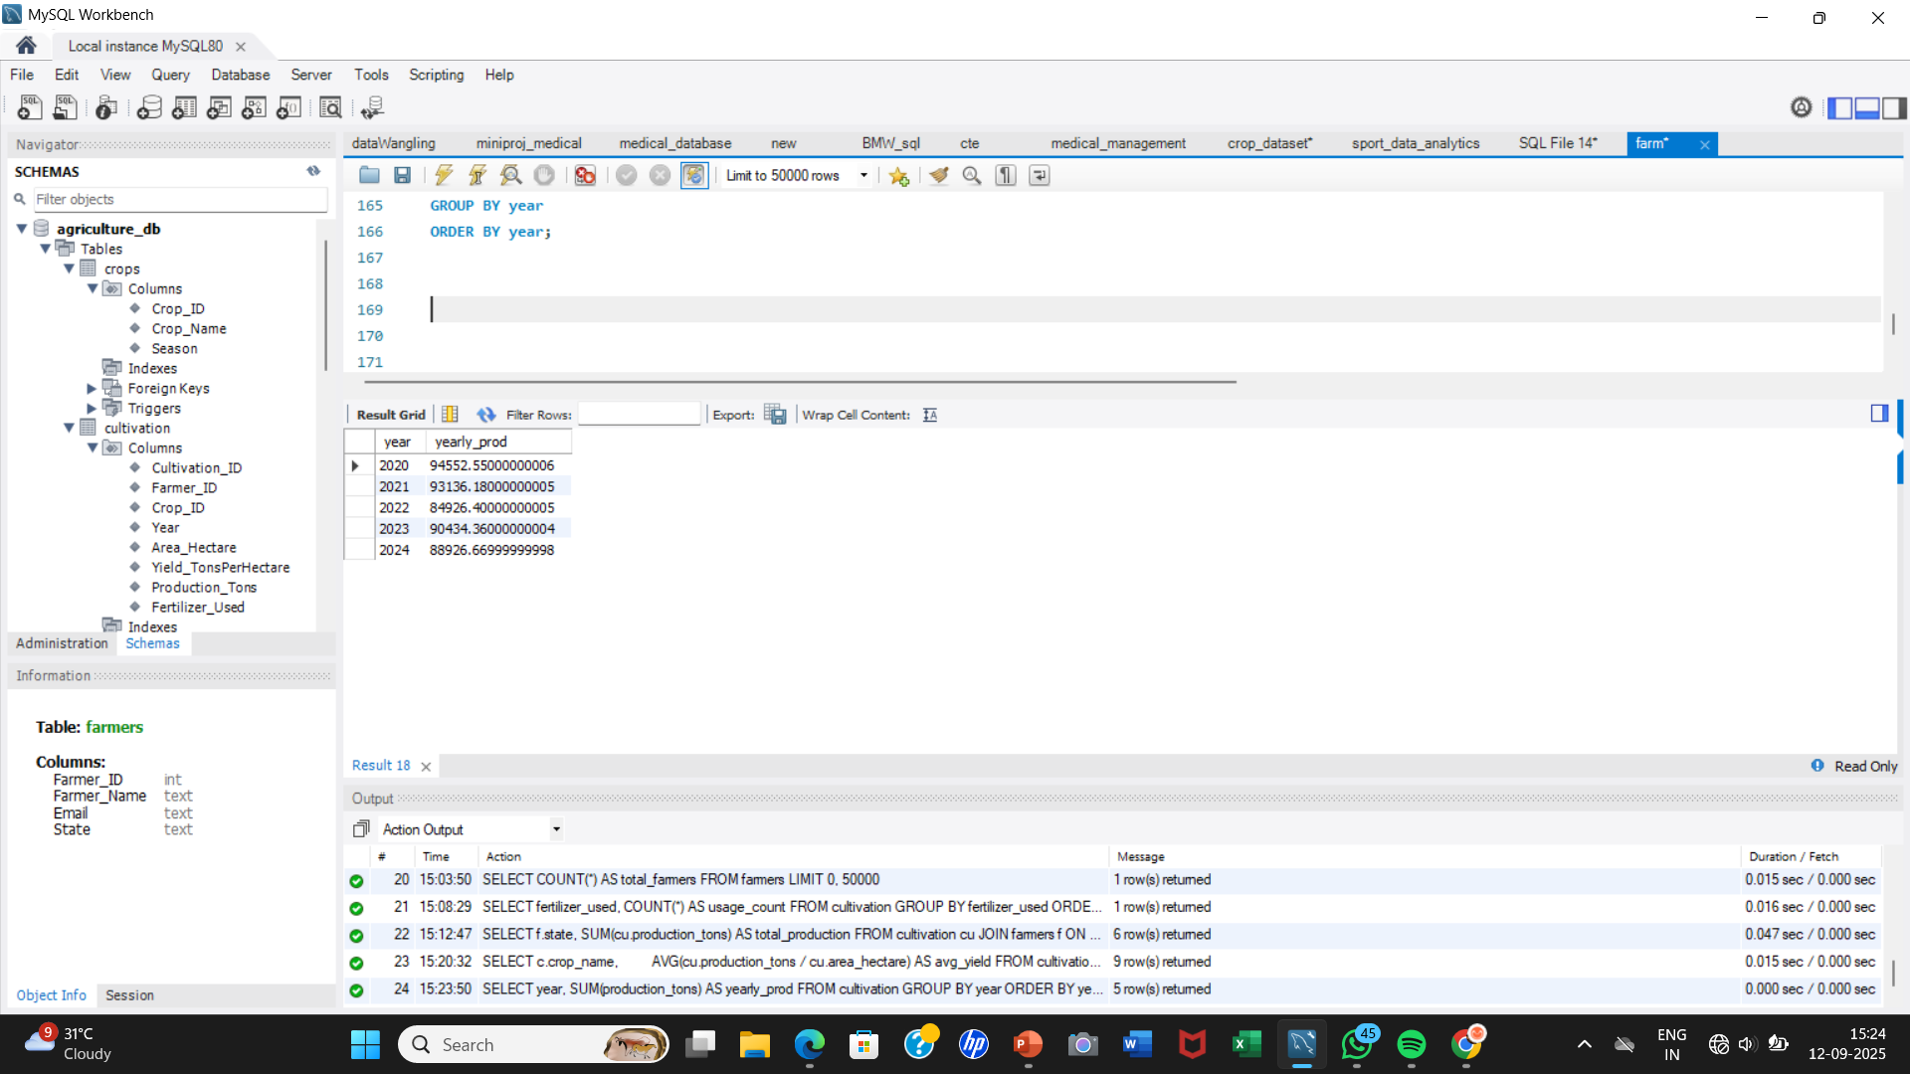
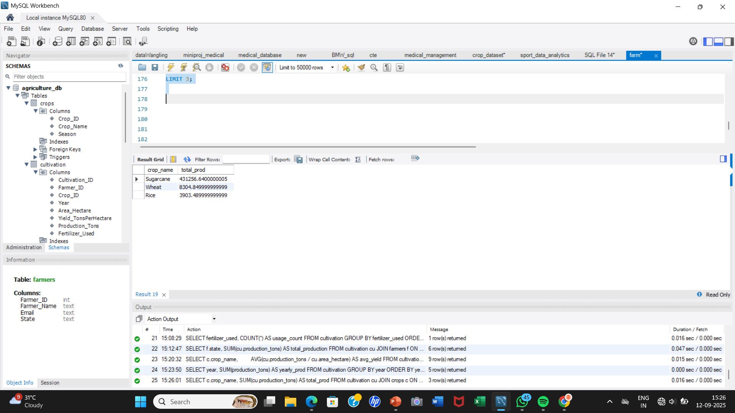
Yearly Trend of Production
SELECT year, SUM(production_tons) AS yearly_prod
FROM cultivation
GROUP BY year
ORDER BY year;
## Shows how production changes over years.
Top 3 Crops by Production
SELECT c.crop_name, SUM(cu.production_tons) AS total_prod
FROM cultivation cu
JOIN crops c ON cu.crop_id = c.crop_id
GROUP BY c.crop_name
ORDER BY total_prod DESC
LIMIT 3;

Slide 8
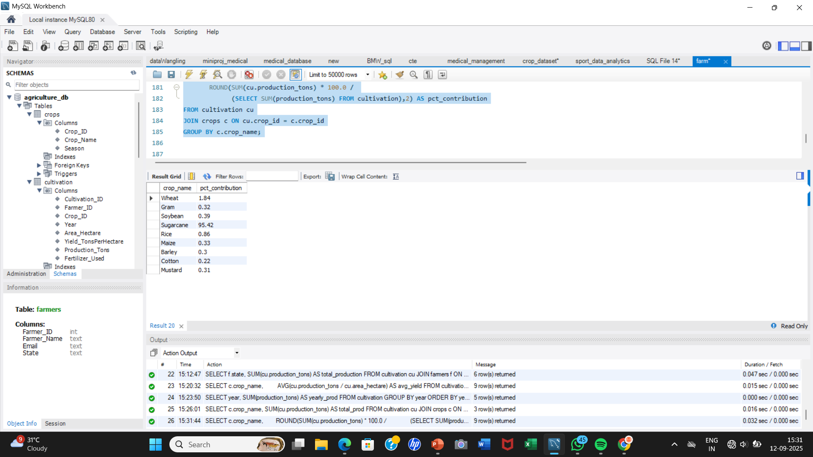
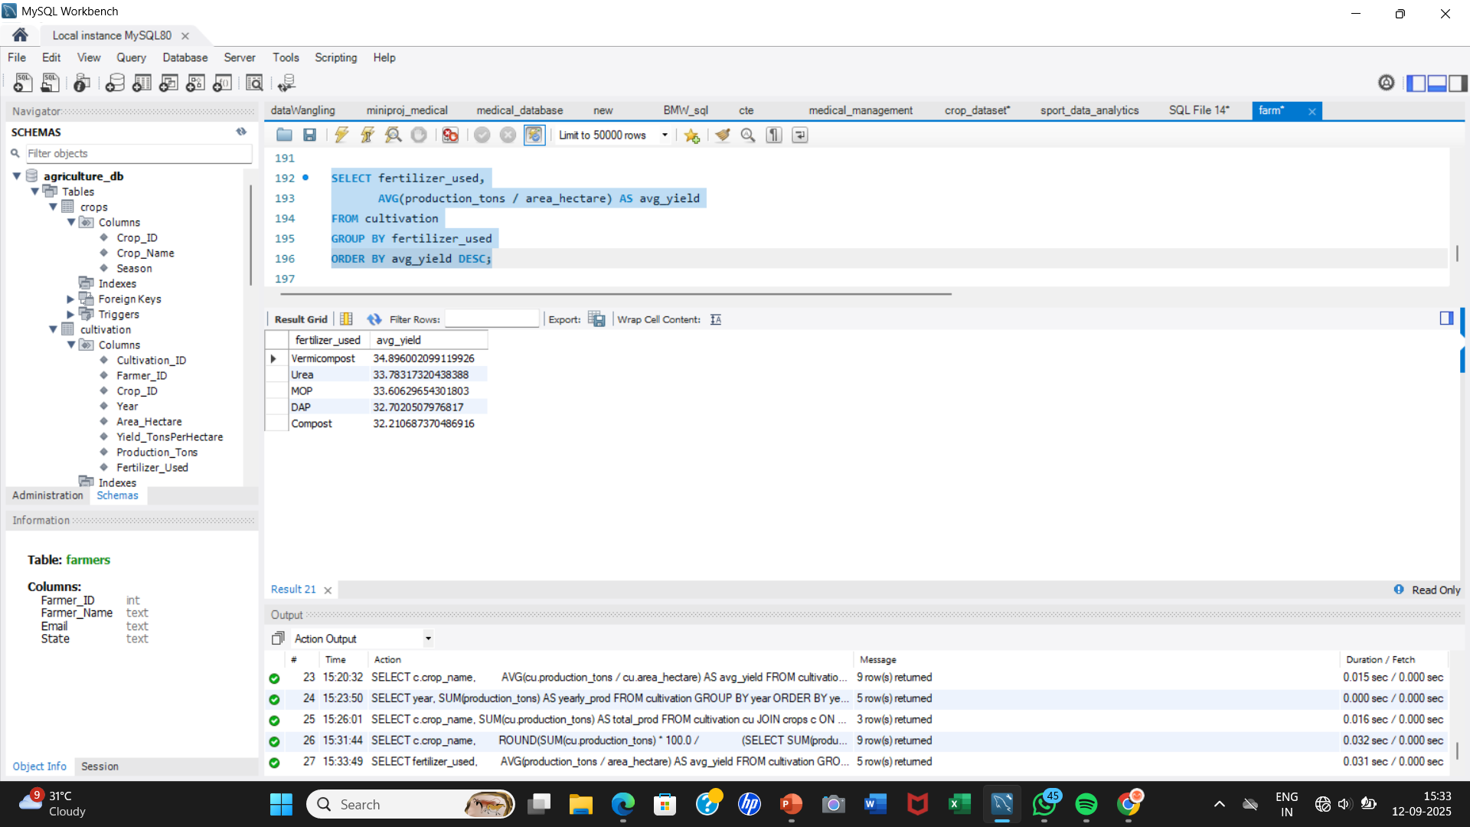
7) Crop Contribution (%)
SELECT c.crop_name,
ROUND(SUM(cu.production_tons) * 100.0 /
(SELECT SUM(production_tons) FROM cultivation),2) AS pct_contribution
FROM cultivation cu
JOIN crops c ON cu.crop_id = c.crop_id
GROUP BY c.crop_name;
Fertilizer vs Yield
SELECT fertilizer_used,
AVG(production_tons / area_hectare) AS avg_yield
FROM cultivation
GROUP BY fertilizer_used
ORDER BY avg_yield DESC;

Slide 9

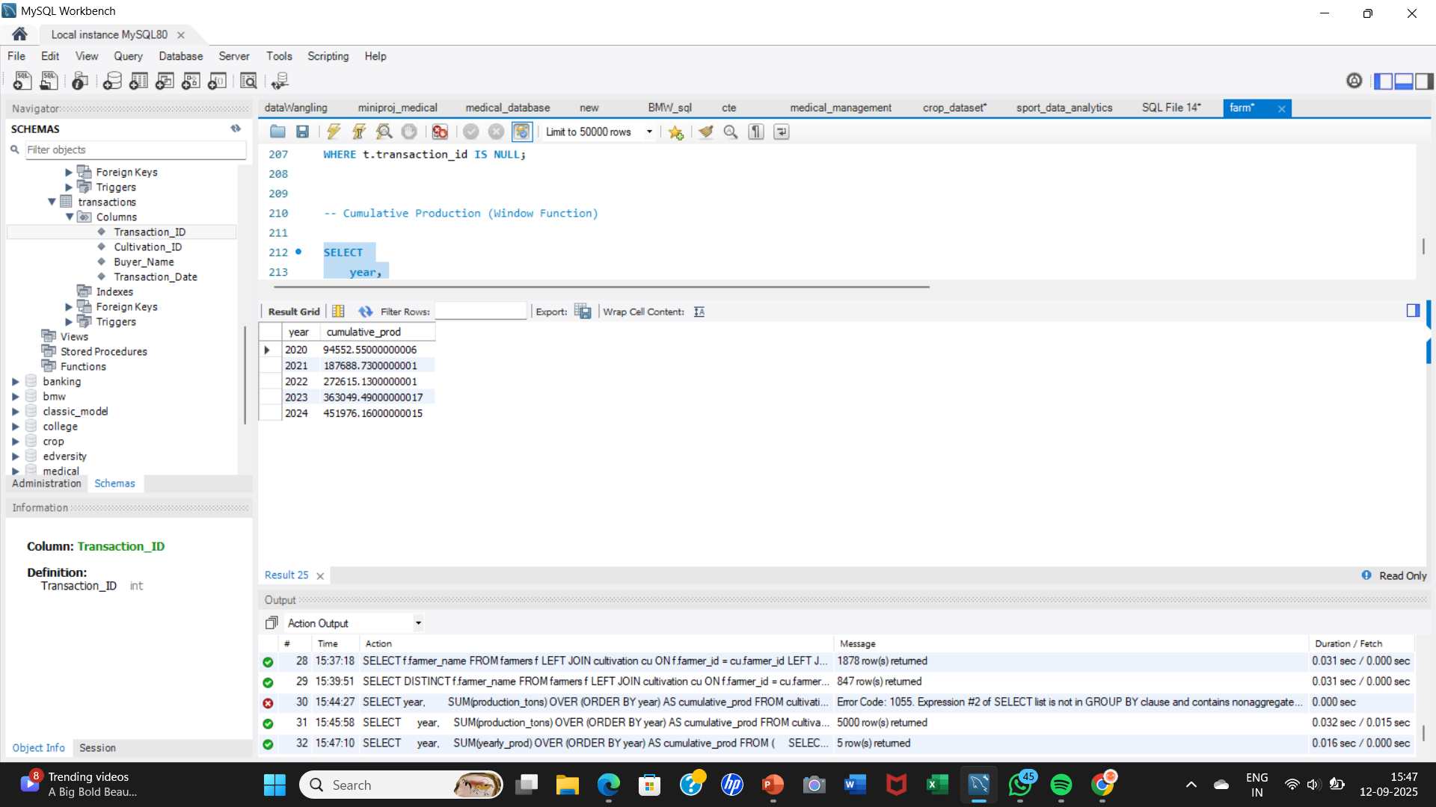
Farmers Without Transactions
SELECT f.farmer_name
FROM farmers f
LEFT JOIN cultivation cu ON f.farmer_id = cu.farmer_id
LEFT JOIN transactions t ON cu.cultivation_id = t.cultivation_id
WHERE t.transaction_id IS NULL;
10) Cumulative Production (Window Function)
SELECT
year,
SUM(yearly_prod) OVER (ORDER BY year) AS cumulative_prod
FROM (
SELECT year, SUM(production_tons) AS yearly_prod
FROM cultivation
GROUP BY year
) AS yearly_data
ORDER BY year;

Slide 10
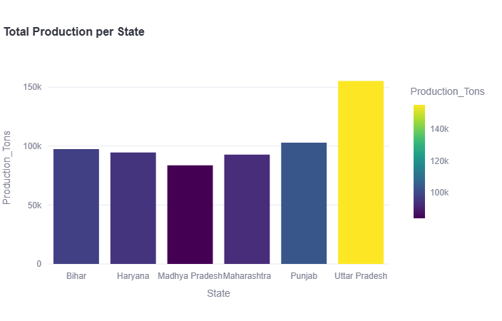
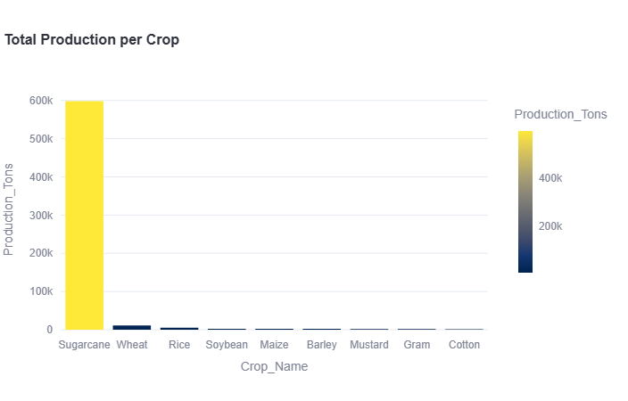
Visualization of the Data

Slide 11
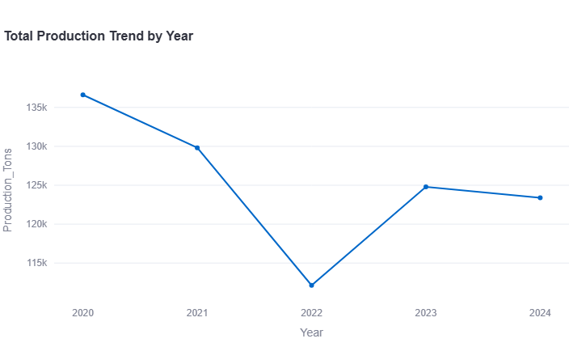
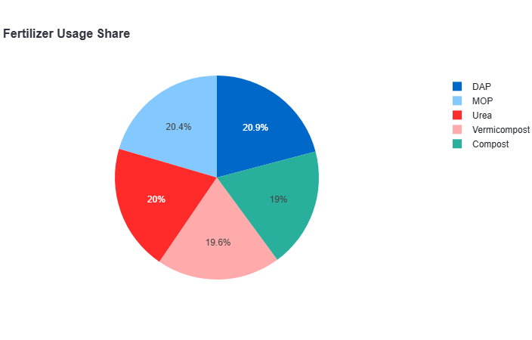

Slide 12
Conclusion
Data wrangling gave insights into:
Most efficient crops & fertilizers
State & Year-wise production trends
Buyer & Farmer transaction patterns
Can help in policy-making, resource allocation, and yield improvement

